Slide 1
Slide Deck 1B: Federal Elections

Slide 2
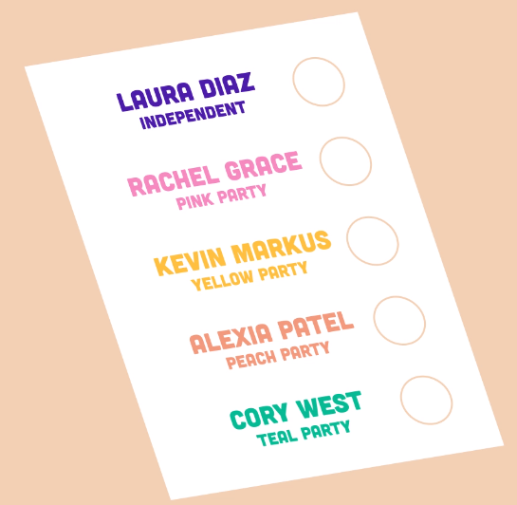
What is our voting system?
Canada uses a system called First-Past-The-Post (FPTP) or Single-Member Plurality.
Only one member is elected in each geographic area.
The rules:
Voters can only choose one candidate on their ballot.
The candidate that receives the most votes wins.

Slide 3
How are candidates elected?
Example: Riding with 1,000 ballots cast.
CANDIDATE NUMBER OF VOTES
Laura Diaz (Independent) 125
Rachel Grace (Pink Party) 400
Kevin Markus (Yellow Party) 110
Alexia Patel (Peach Party) 340
Corey West (Teal Party) 25

Slide 4
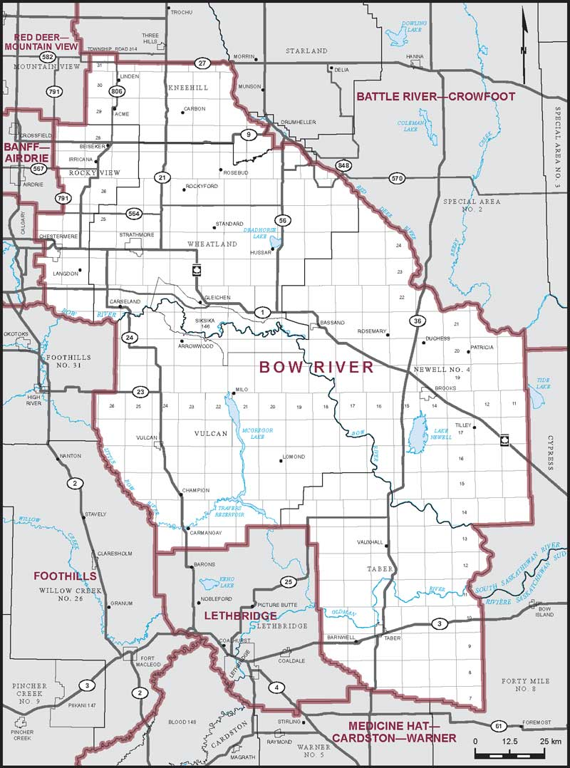
Federal ridings
Canada is divided into 338 geographic areas called ridings. Also known as constituencies.
One MP is elected per riding.
The size and shape of ridings is determined by population size, geography, culture and language.
The number of people represented in each riding is supposed to be as equal as possible.

Slide 5
How are ridings distributed across Canada?
Province or Territory | Number of Ridings
British Columbia | 42
Alberta | 34
Saskatchewan | 14
Manitoba | 14
Ontario | 121
Quebec | 78
New Brunswick | 10
Prince Edward Island | 4
Nova Scotia | 11
Newfoundland and Labrador | 7
Yukon | 1
Northwest Territories | 1
Nunavut | 1
Total | 338

Slide 6
Minority vs Majority
If the winning political party has more than half of all seats (170+), they will have a majority government.
If they have less than half (169 or less), they will have a minority government.
In order to pass any legislation or budgets, the bills must have support from more than half of the Members of Parliament.

Slide 7
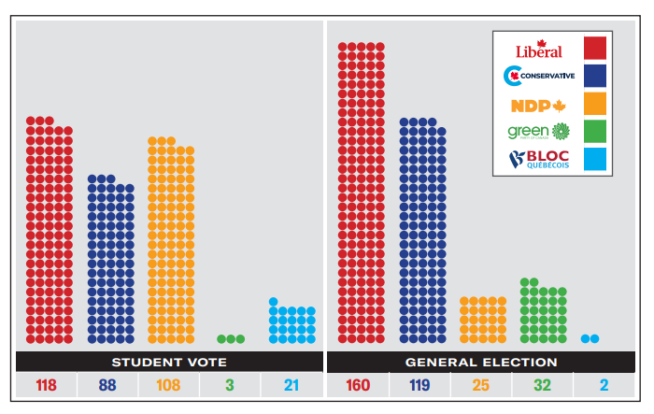
2021 Election Results: Students vs Adults

Slide 8
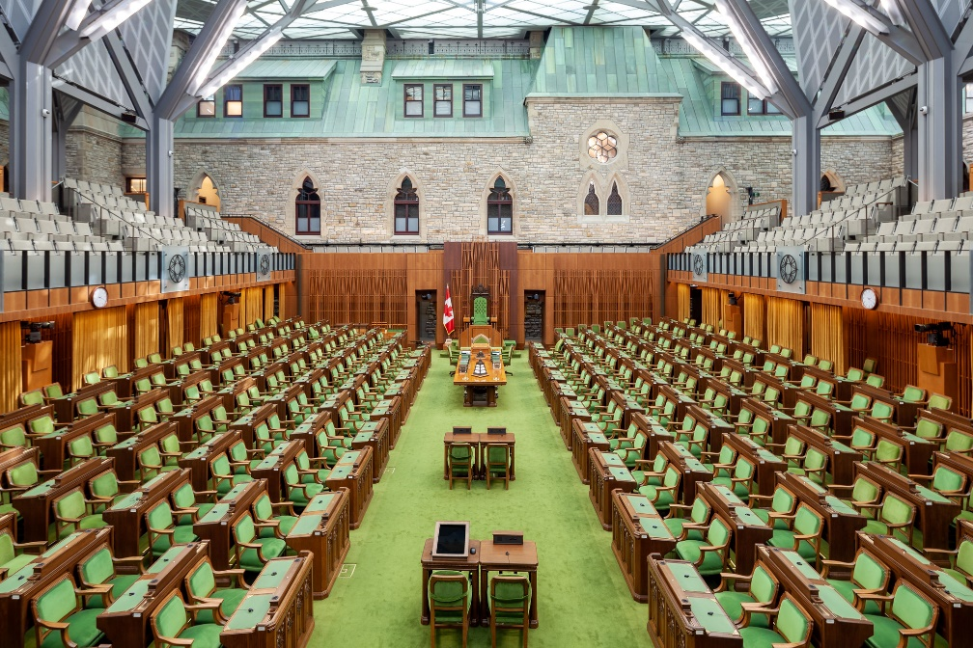
Discussion
What are the challenges and opportunities with a minority government?
Do you think having a minority government is good or bad for the country? Why?

