Slide 1
Trivia Game: Government in Canada

Slide 2
How many levels of government are there in Canada?
2
5
3
6

Slide 3
How many levels of government are there in Canada?
2
5
3
6

Slide 4
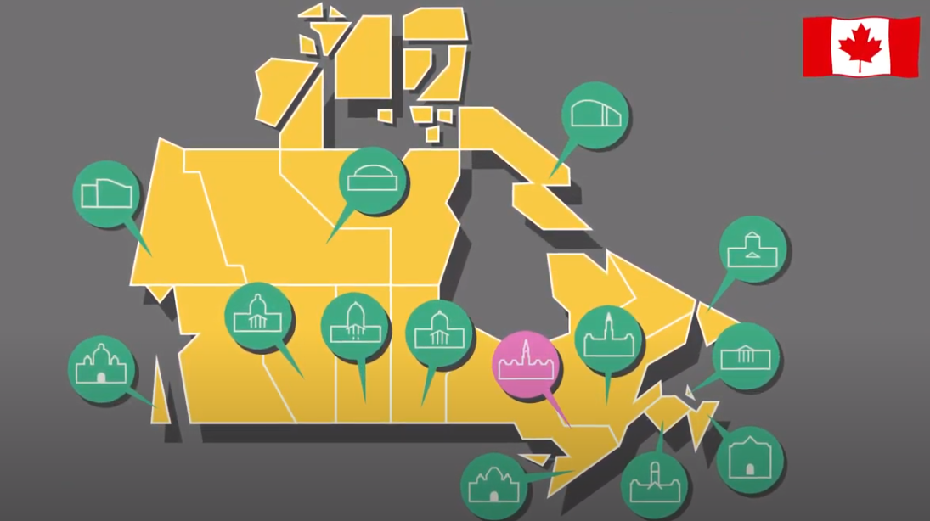
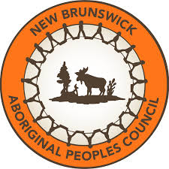
There are three main levels of government in Canada.
Municipal
Provincial/Territorial
Federal
Some First Nations, Inuit, and Métis communities have their own systems of governance. They share certain responsibilities with other levels of government.

Slide 5
Which of the following is not a responsibility of the federal government?
National defence
Immigration
International trade
Animal control

Slide 6
Which of the following is not a responsibility of the federal government?
National defence
Immigration
International trade
Animal control

Slide 7
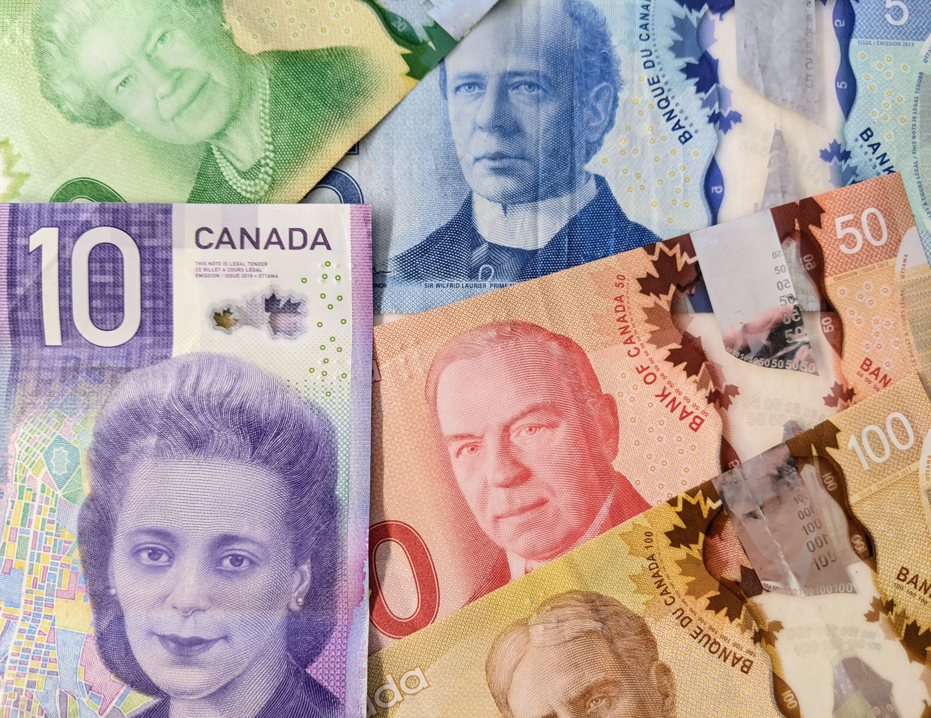
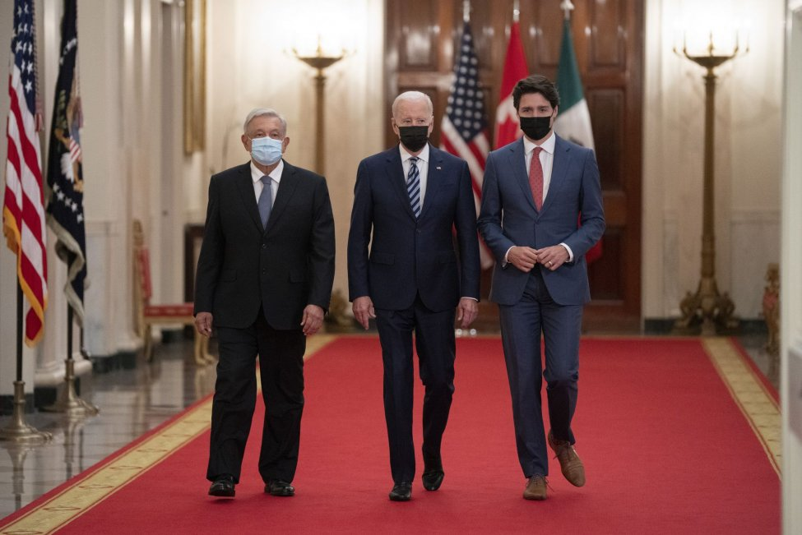
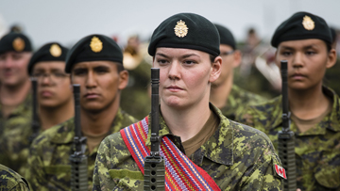
The federal government is responsible for issues that affect the whole country.
Immigration, citizenship and passports
National defence
Criminal law
International trade and foreign affairs
Indigenous lands and rights
Official languages
Fisheries and oceans
Currency

Slide 8
Which of the following is not a responsibility of the provincial/territorial government?
Water supply
Education
Hospitals
Highways

Slide 9
Which of the following is not a responsibility of the provincial/territorial government?
Water supply
Education
Hospitals
Highways

Slide 10
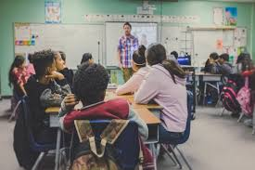
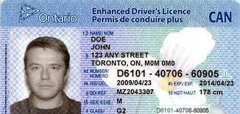
The provincial or territorial government is responsible for issues that affect their own province or territory.
Colleges and universities
Drivers’ licensing and highways
Education
Hospitals and healthcare
Municipalities
Natural resources
Provincial law and courts
Social services

Slide 11
Which of the following is not a responsibility of the municipal government?
Garbage and recycling
Postal service
Recreation facilities
Fire protection

Slide 12
Which of the following is not a responsibility of the municipal government?
Garbage and recycling
Postal service
Recreation facilities
Fire protection

Slide 13
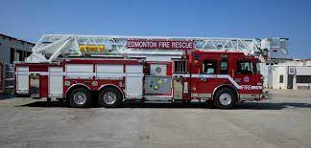
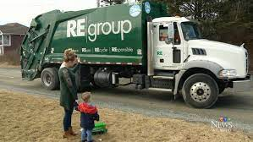
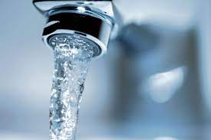
The municipal government is responsible for issues that affect their community. They receive their responsibilities from their province/territory.
Animal control
Fire protection
Land use planning (zoning)
Local parks
Police services
Road maintenance
Recreation and community facilities
Public transportation (if applicable)
Garbage and recycling
Water supply and treatment

Slide 14
What is the title given to the
federal elected representative?
Member of the National Assembly
Member of Parliament
Member of the Legislative Assembly
Councillor

Slide 15
What is the title given to the
federal elected representative?
Member of the National Assembly
Member of Parliament
Member of the Legislative Assembly
Councillor

Slide 16
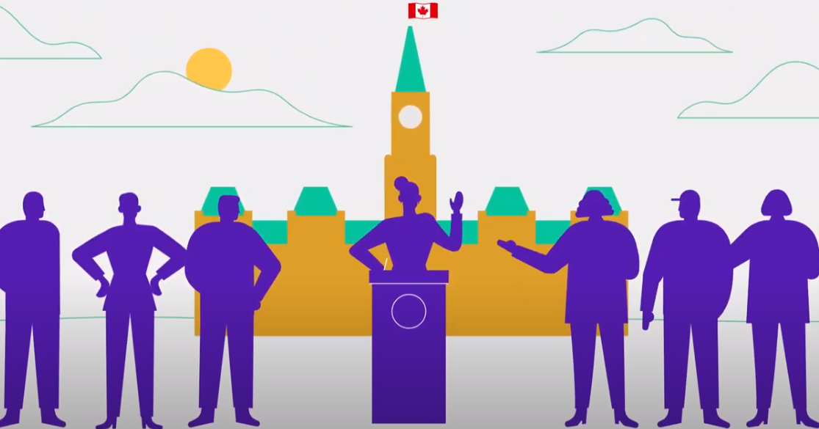
Federal elected representatives are called Members of Parliament, or MPs for short.
Depending on where you live, the provincial or territorial elected representatives are known as:
Members of the Legislative Assembly;
Members of Provincial Parliament (ON);
Members of the National Assembly (QC); or
Members of the House of Assembly (NL)
At the municipal level, our elected representatives are normally called councillors, or aldermen.

Slide 17
In what city do Members of Parliament gather?
Quebec City
Toronto
Ottawa
Gatineau

Slide 18
In what city do Members of Parliament gather?
Quebec City
Toronto
Ottawa
Gatineau

Slide 19
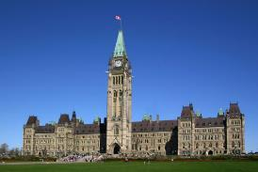
Federal elected representatives gather to debate and pass laws in the House of Commons in Ottawa.
Provincial/territorial representatives meet at their legislatures in the capital of the province or territory.
Councillors or aldermen meet at their city or town hall.

Slide 20
What is the title given to the leader of the government at the federal level?
Premier
Mayor
Governor General
Prime Minister

Slide 21
What is the title given to the leader at the federal level?
Premier
Mayor
Governor General
Prime Minister

Slide 22
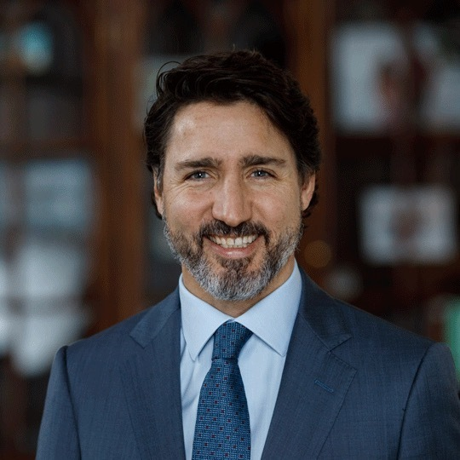
Each level of government has a leader:
Federal government = prime minister
Provincial or territorial government = premier
Municipal level = mayor or reeve

