Slide 1
Slide Deck 1A: What do you know?

Slide 2
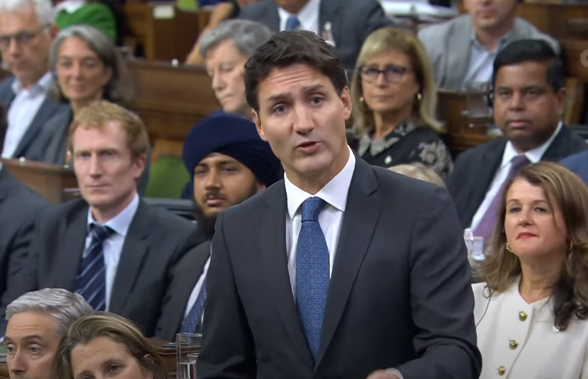
Tell me anything you know related to this image

Slide 3
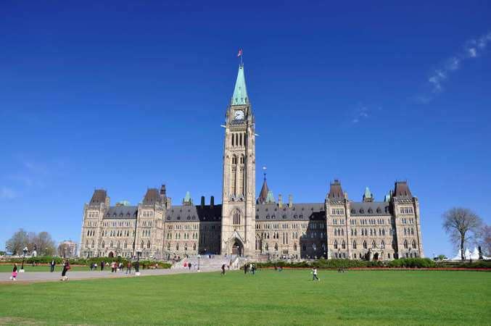
What do you know about how government is organized in Canada?

