Slide 1


SLIDE DECK 1B: Trivia Game

Slide 2
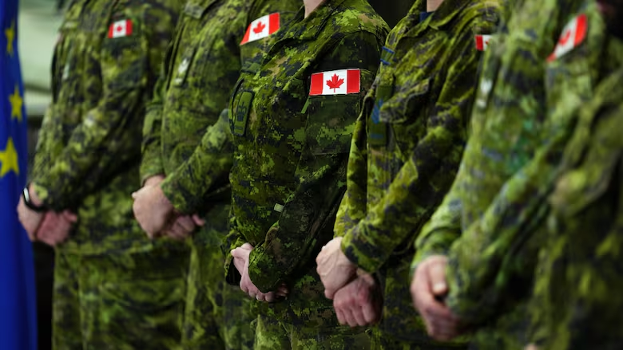
TRIVIA QUESTION #1
Which level of government is responsible for national defence?
a) Provincial
b) Municipal
c) Federal
d) Indigenous

Slide 3
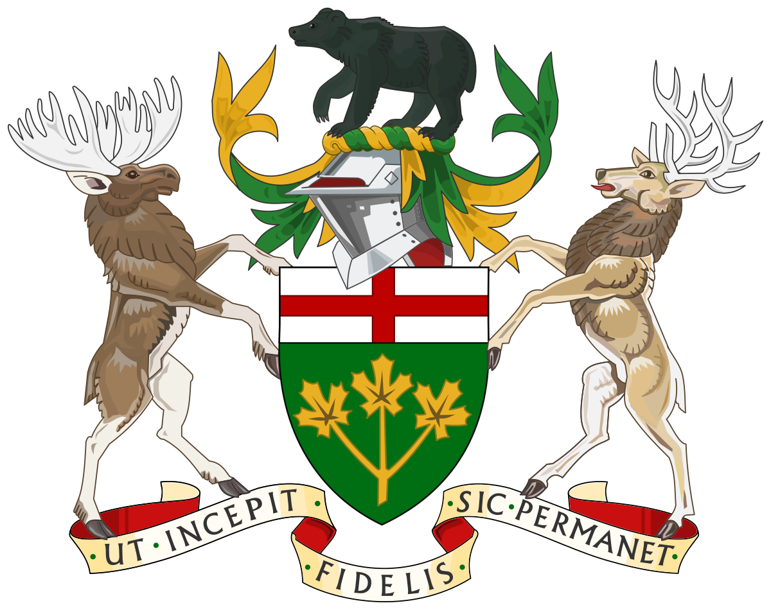
TRIVIA QUESTION #2
What is the title of the leader of the provincial government?
a) Mayor
b) Premier
c) Prime Minister
d) Councillor

Slide 4
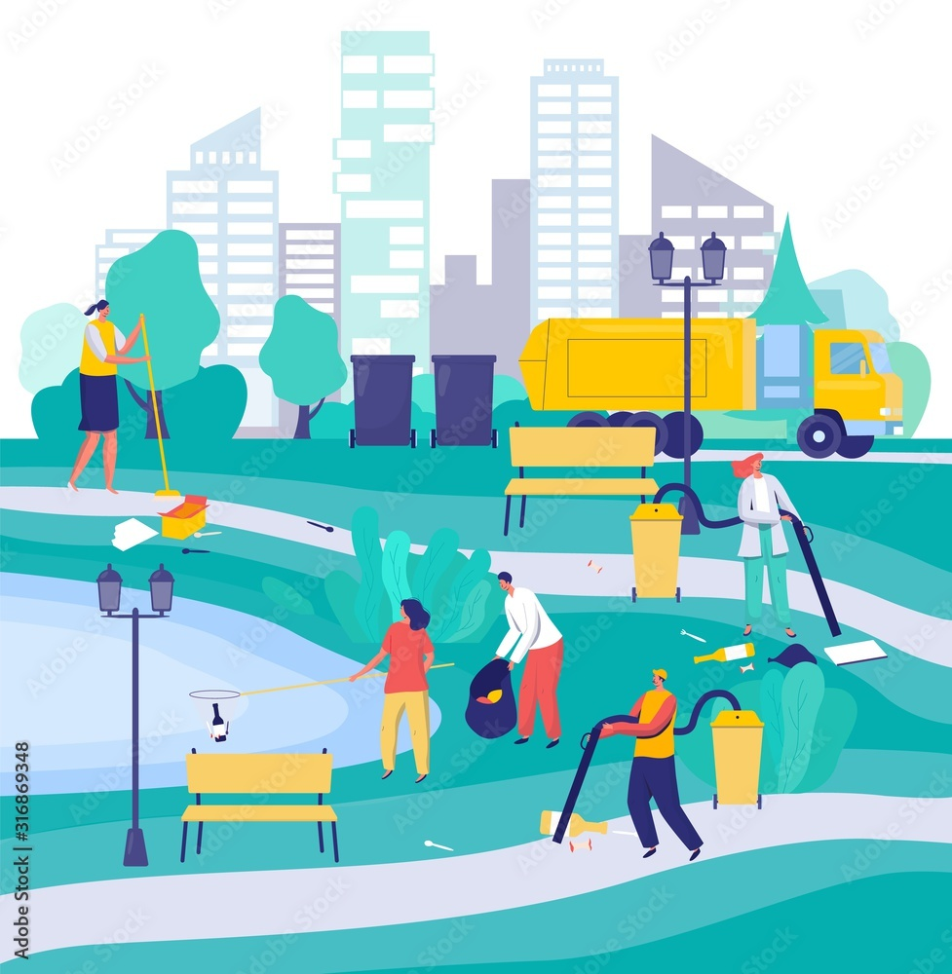
TRIVIA QUESTION #3
Which level of government handles road maintenance and local parks?
a) Federal
b) Provincial
c) Municipal
d) Territorial

Slide 5
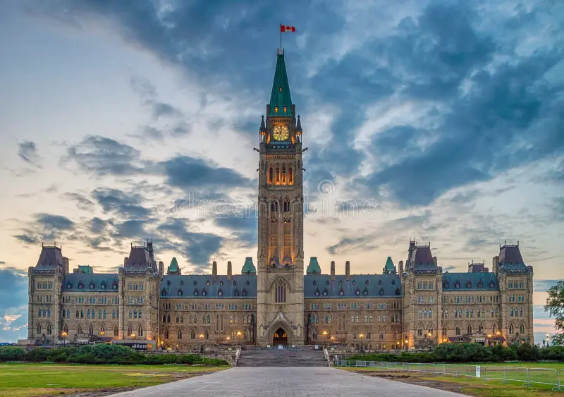
TRIVIA QUESTION #4
In which city is the House of Commons located?
a) Toronto
b) Vancouver
c) Ottawa
d) Montreal

Slide 6
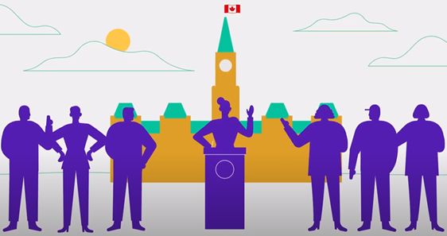
TRIVIA QUESTION #5
Representatives at the federal level are called __________.

Slide 7
TRIVIA QUESTION #6
The leader of the municipal government is known as a __________ or __________.
Notes:
Feel free to personalize this with your municipal government.

Slide 8
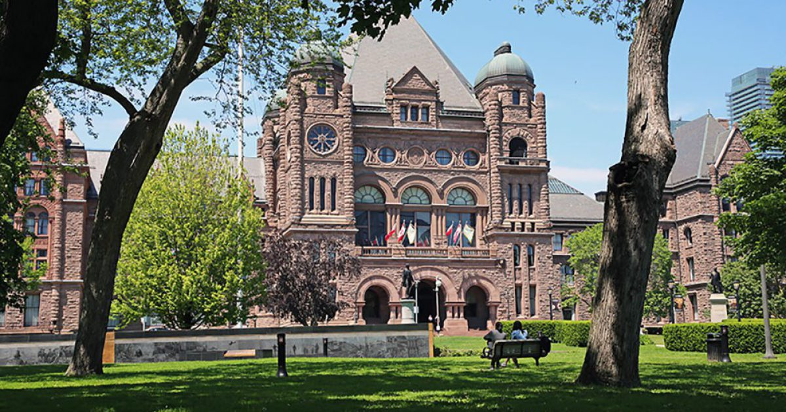
TRIVIA QUESTION #7
Each level of government gathers to debate and pass laws in a specific building.
The provincial building is called the __________.

Slide 9
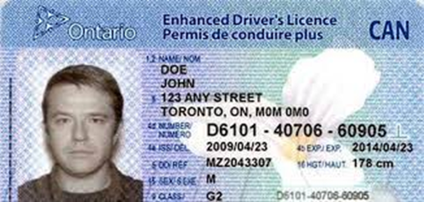
TRIVIA QUESTION #8
True or False: The federal government is responsible for drivers’ licensing.

Slide 10
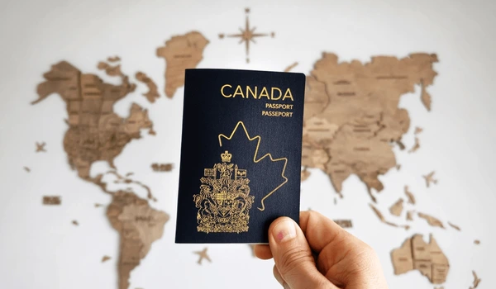
TRIVIA QUESTION #9
True or False: Municipal governments manage immigration and issue passports.

Slide 11

TRIVIA QUESTION #10
True or False: The Prime Minister is the leader of the federal government.

Slide 12

TRIVIA QUESTION #11
True or False: Indigenous governance systems sometimes share responsibilities with municipal governments.

Slide 13
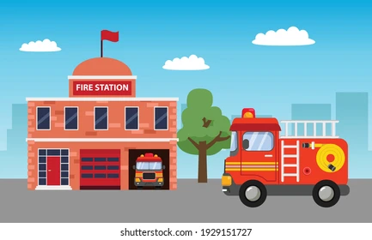
TRIVIA QUESTION #12
Who is responsible for fire protection in your community?
a) Federal government
b) Municipal government
c) Provincial government
d) None of the above

Slide 14
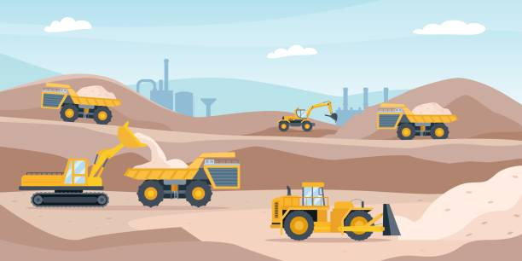

TRIVIA QUESTION #13
Which level of government manages natural resources, such as forests and mines?
a) Municipal
b) Provincial
c) Federal
d) Territorial

Slide 15
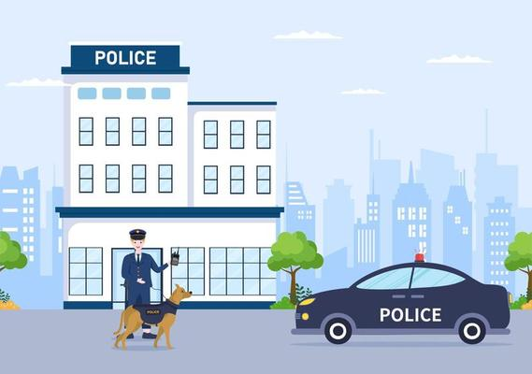
TRIVIA QUESTION #14
What level of government oversees local police services?
a) Federal
b) Provincial
c) Municipal
d) All of the above

Slide 16

TRIVIA QUESTION #15
True or False: The provincial government is responsible for education in Canada.

Slide 17
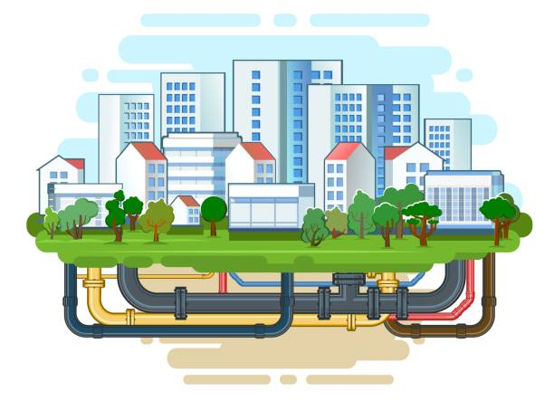
TRIVIA QUESTION #16
True or False: The federal government is in charge of water treatment and supply.

Slide 18
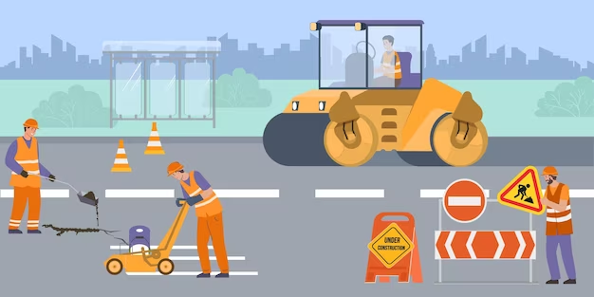
TRIVIA QUESTION #17
True or False: Municipal governments maintain highways and issue driver’s licenses.

Slide 19
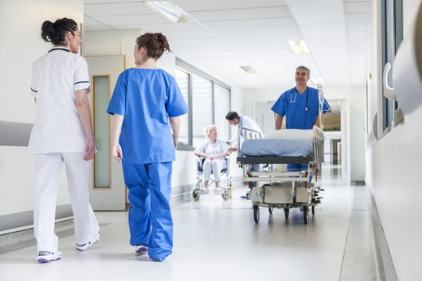
TRIVIA QUESTION #18
The __________ government is responsible for hospitals and healthcare.

Slide 20
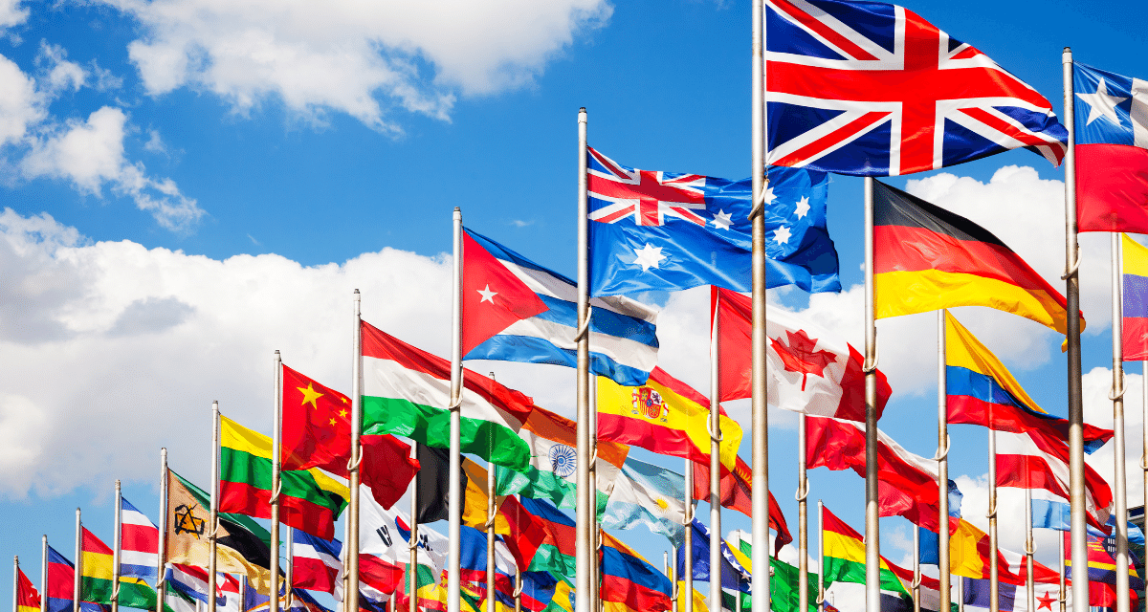
TRIVIA QUESTION #19
__________ and __________ are two responsibilities of the federal government related to international relations.

Slide 21
TRIVIA QUESTION #20
What does a representative democracy mean?

