Slide 1


SLIDE DECK 1A: Governments in Canada

Slide 2
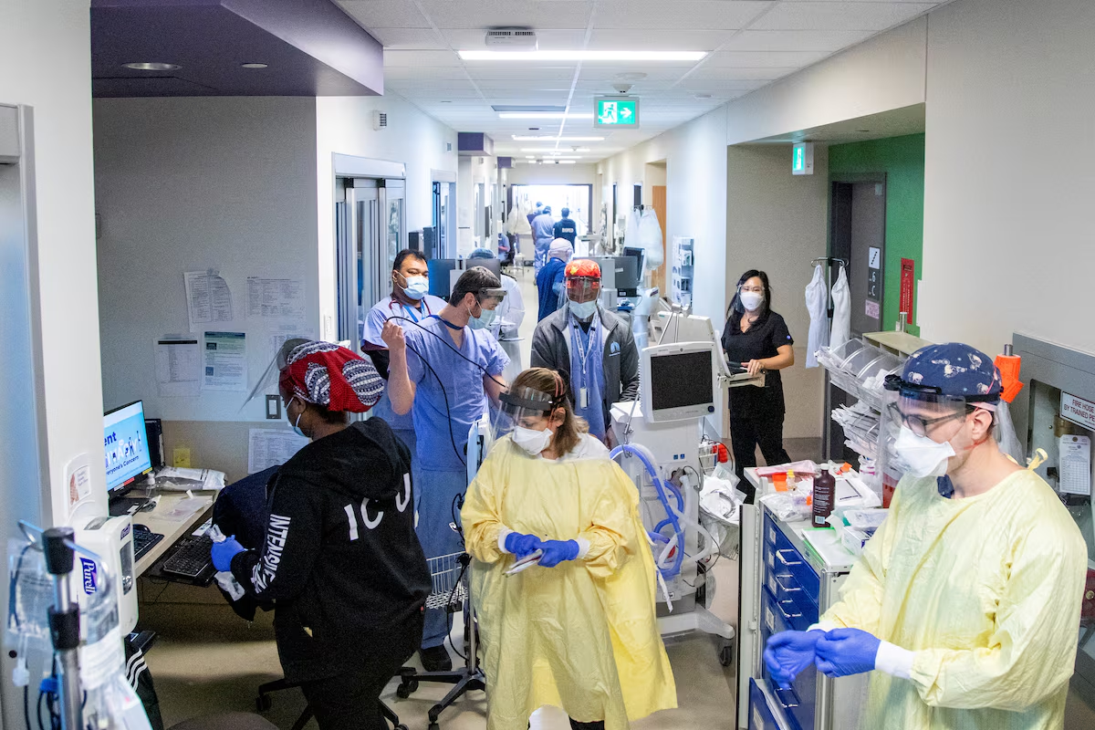
Notes:
Healthcare delivery and hospitals (Provincial)

Slide 3
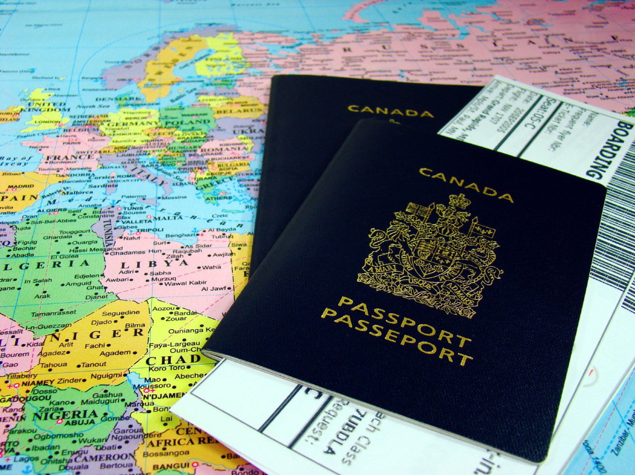
Notes:
Immigration and passports (Federal)

Slide 4
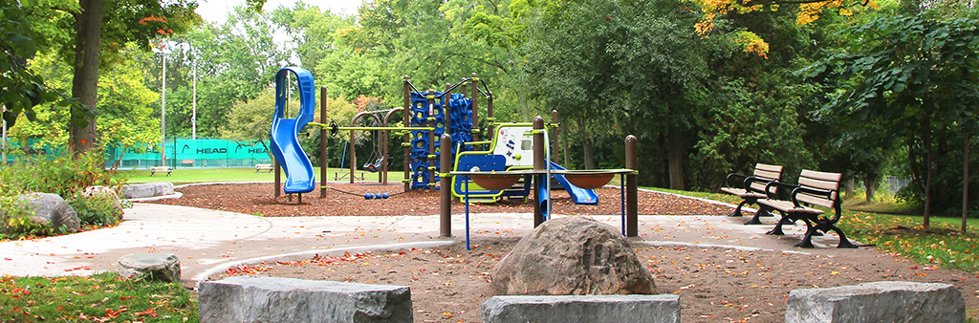
Notes:
Local playgrounds (Municipal)

Slide 5
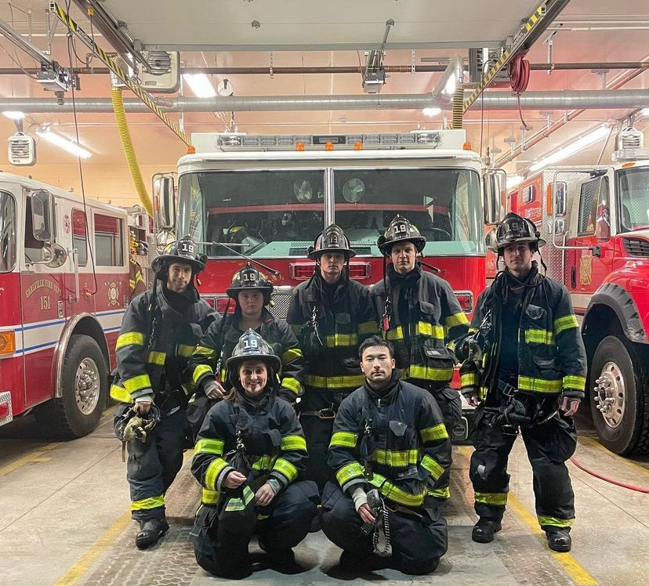
Notes:
Fire protection (Municipal)

Slide 6
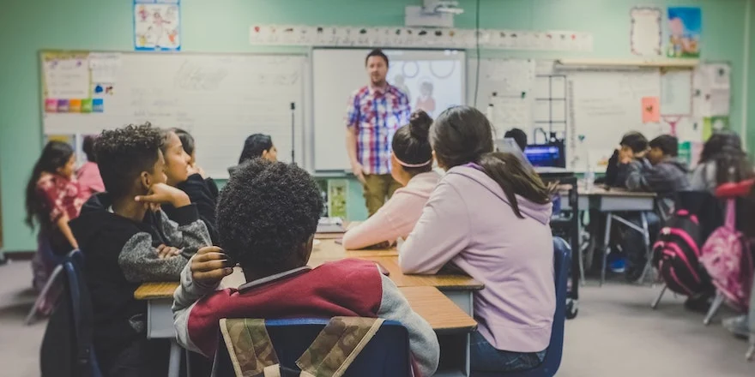
Notes:
K-12 Education (Provincial)

Slide 7
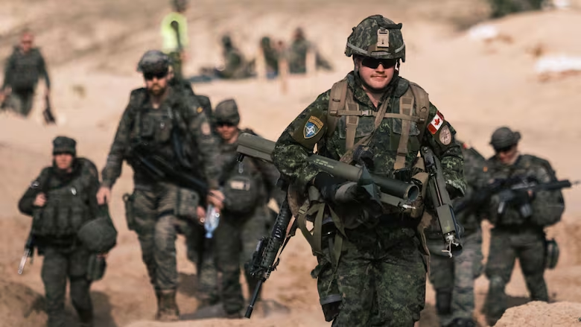
Notes:
Military/National defence (Federal)

Slide 8
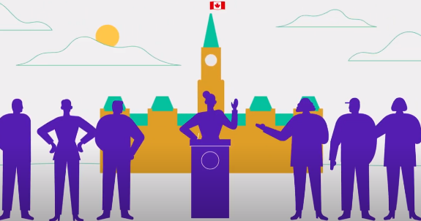
Guiding Question
What is a representative democracy?

Slide 9
Representative Democracy
Representatives (or politicians) are chosen by people through elections.
Each representative is responsible for a different geographic area or community.
Representatives gather together to debate issues and pass laws.

Slide 10
Levels/Orders of Government
There are three levels or orders of government in Canada. Each level has its own group of elected representatives.
Federal
Provincial/Territorial
Municipal
Some First Nations, Inuit, and Métis communities have their own systems of governance. They share certain responsibilities with other levels of government.

Slide 11
Elected Representatives
Elected Representatives
Each government has a different name for its elected representative.
Level | Name
Federal | Member of Parliament (MP)
Provincial | Member of Provincial Parliament (MPP)
Municipal | Councillor or Alderman

Slide 12
Legislative Buildings
Each level has its own building where representatives gather to debate and pass laws.
Level | Building | Location
Federal | House of Commons | Ottawa
Provincial | Legislative Assembly | Toronto
Municipal | City or town council | The city/town

Slide 13
Leaders
Each level of government has a different name for its leader.
Level | Leader’s Title
Federal | Prime Minister
Provincial | Premier
Municipal | Mayor or Reeve

Slide 14
Some Federal Responsibilities
Citizenship and passports
National defence
Criminal law
Fisheries and oceans
Foreign affairs and international trade
Heritage and culture
Infrastructure and communities
Services for Indigenous communities
Public safety and risk management
Environment

Slide 15
Some Provincial Responsibilities
K-12 Education
Colleges and universities
Hospitals and healthcare
Natural resources
Emergency management
Drivers’ licensing and highways
Children and family services
Community and social services (support for seniors, low income, disabled people)

Slide 16
Some Municipal Responsibilities
Animal control
Fire protection
Land use planning
Local parks
Road maintenance
Police
Public transit
Recreation and community facilities
Water supply and treatment

